Slide 1

DASHING THROUGH the CRYPTO SNOW
By: Ethan, Danny and Yen

Slide 2
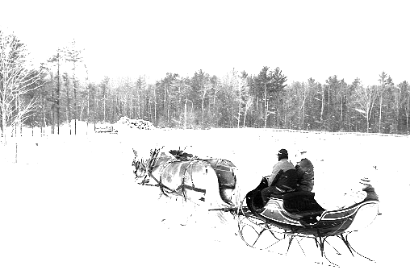
Agenda
Concept
Data Techniques
Approach
Demo
Answers to Problem Statement
Summary
Next Steps

Slide 3
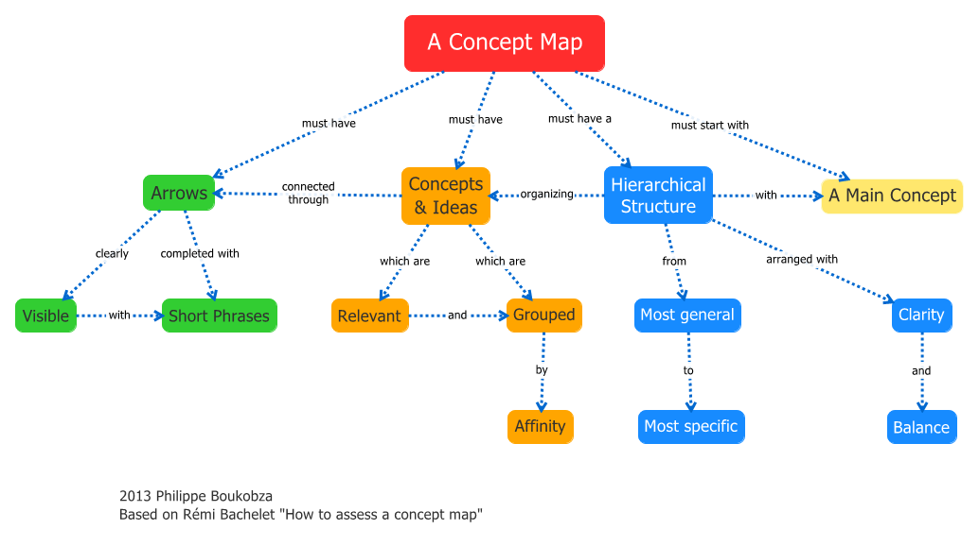
CONCEPT
Problem Statement:
Can we outperform the S&P 500 with our strategy of utilizing more volatile assets?
What is the strategy performance over the past year?
Is it always better to buy more volatile assets?
Motivation for development?
Identify a strategy to make money in the current market
Apply the tools and concepts we learned in class in our own portfolio
User stories:
Utilize Quant library to build Dashboard
Validate Quant library results using Alpaca API and the concepts we learned in class
Create Quant Dashboard
Create Our Strategy Dashboard

Slide 4

DATA TECHNIQUES
Description of data source:
QuantStat Portfolio Library – have a built in API to extract data from Yahoo! Finance. Offer visual analysis to use in portfolio management with little coding
Alpaca Markets API – to extract cryptos and stocks data
Reasoning for data selection:
Selected BTC, ETH, TRX, TSLA, and GME because of its volatility
Plotted volatility of BTC, ETH, TRX, TSLA and GME against SP500 to show that the selected assets are more volatile
Collection, exploration and cleaning process.
Researched and selected FinTech Python Library (Quantstat)
Utilized Alpaca Markets API to retrieve asset data by using the get function and storing it in Pandas Dataframe
Scrubbed data sets using dropna(), drop columns, reindex to date, pct_change(), std(), sharpe ratios(), corr(), etc.

Slide 5
APPROACH
Technologies used
GitHub/Jupyter Lab/VS Code
Alpaca Markets and Yahoo! Finance APIs
HvPlot, Seaborn, dotenv, and Quantstat Library
Breakdown of tasks and roles:
Identify Problem Statement - Danny, Ethan and Yen
Identify and select Library - Yen
Create a rough draft of the code - Ethan
Import project-specific data - Yen
Clean up codes for Notebook #1- Yen & Danny
Write new formulas in Notebook #1 - Yen
Create Notebook#2 with logic and reasoning - Ethan
Create README. Md file - Ethan & Yen
Create Google presentation - Danny, Ethan, and Yen

Slide 6
APPROACH
Challenges
Utilization of Github and merging capability
Utilization of QuantStat - existing bug in the reports functionality(TypeError: Cannot compare dtypes datetime64[ns, America/New_York] and datetime64[ns])
Aggregation of timestamps
Creation of annotated heatmap
Coordination among team members
Successes
Utilization of MVP concept to build our dashboard
Collaboration to complete our deliverables at the end
Working codes

Slide 7
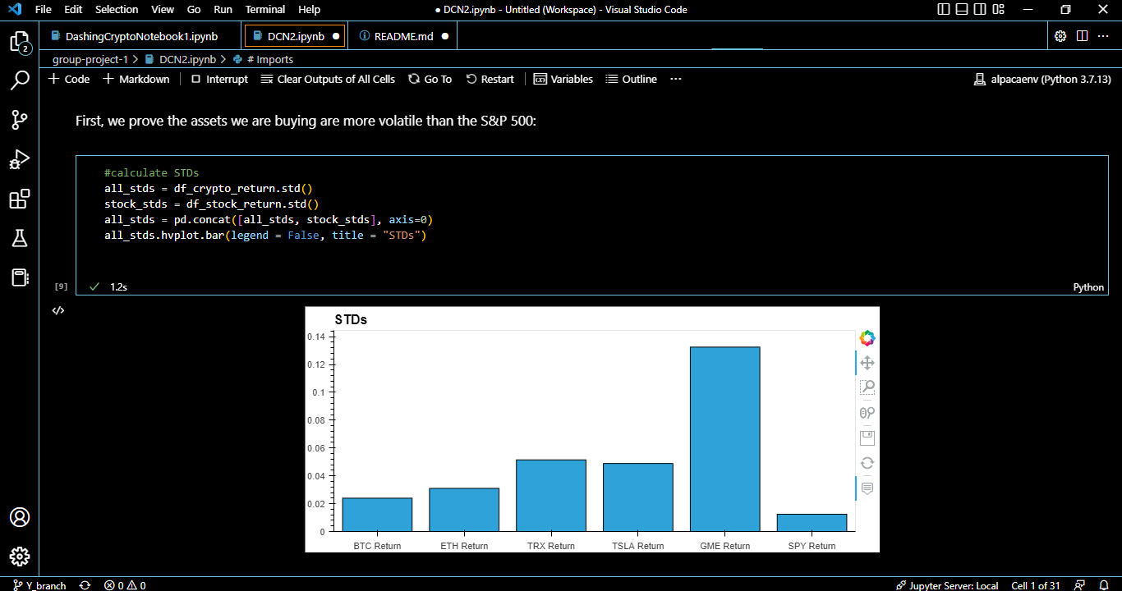
DEMO

Slide 8
Answers to Problem Statement
Can we outperform the S&P 500 with our strategy of utilizing more volatile assets?
We created a portfolio that had a high probability to outperform the SPY, however due to market condition we did not. We did choose assets with lower liquidity, because of less participation in the assets than the SPY, the asset movement was greater than the SPY
What is the strategy performance over the past year?
Our strategy was to compare the performance of SPY with other assets that have lower liquidity and high volatility than the SPY. We did use different type of indicators(tools) in our strategy.
It is important to have a prediction of the market movement that can help us determine if we can handle the ups and downs of the portfolio. In our case, we decide to hold it for a long period.
Is it always better to buy more volatile assets?
Investing is a risky game and the volatility of an asset can carry a high risk but also high reward. Our strategy is to buy the high volatile assets but we expose ourselves to high risk. We can conclude that it is better to buy assets that have high reward probability but invest money that you can afford to lose.

Slide 9
SUMMARY
According to our findings, it is not always better to buy the more volatile assets. When we sample data from the past year, we can see that volatile assets have greater exposure to the down side than the S&P 500. In the past year, many economists would classify risk-on assets as being in a bear market. One could conclude that when markets are in turmoil, assets that can move more quickly will move more quickly to the down side than less volatile assets. This is due to the available liquidity. The S&P 500 is one of the most traded and widely available assets in the world while TRX is not well-known and only available certain places. This leads to S&P500 having a lot of trust and TRX not so much, people with lots of money feel comfortable putting and most importantly keeping large sums of money into very trusty and very liquid assets. Since S&P 500 has more liquidity than TRX, it takes billions of more dollars to push the price down 60% in a day where TRX it could only be millions of dollars. You have some of the largest corporations like Vanguard and BlackRock offering S&P 500 ETF versus cryptic internet addresses offering TRX through (de)centralized exchanges.
In essence, we had a good idea on what would allow us to outperform the SPY Benchmark, however due to current state of markets and recent turmoil, our strategy backfired. Outperforming the SPY means taking on extra risk in order to do so. We wanted to pick assets with lower liquidity than the SPY so that way when the markets are going up, our assets require less capital to move than the S&P 500. This thought-process however, applies in both directions. In accordance with our findings, our more volatile assets moved to the downside faster and easier than the SPY. Given the past year and its data, it would have simply been best to stay in cash and rebuy in lower or to allocate more of a percentage of our portfolio to less risky assets like the SPY (if we were possibly worried about missing a future buying opportunity). We created a portfolio to outperform the SPY, however over the past year, like many other hedge funds and portfolio managers, we did not.

Slide 10
NEXT STEPS
Additional questions that surfaced
Are there crypto coins,sectors and/or industries that are outperforming S&P 500?
If so, are they more volatile in the bull/bear/neutral market?
Additional topics to research
Integration with other technical indicators such moneyflow, rsi, candlestick pattern bullish/bearish breakaway
How to track liquidity of markets and how its influx influences the price
Plan for future development
Create algo-trading bot which incorporates our analysis

Slide 11
LINKS
Deployed application:
Notebook #1: https://github.com/dannynday/group-project-1/blob/main/DashingCryptoNotebook1.ipynb
Notebook #2: https://github.com/dannynday/group-project-1/blob/main/DCN2.ipynb
Readme: https://github.com/dannynday/group-project-1/blob/main/README.md
GitHub repo: https://github.com/dannynday/group-project-1

